Slide 1

Capstone Project-II
Yes Bank Stock Closing Price Prediction
Kumar Vijay Mhaske

Slide 2
About Project:
Yes Bank is a well-known bank in the Indian financial domain. Since 2018, it has been in the news because of the fraud case involving Rana Kapoor. Owing to this fact, it was interesting to see how that impacted the stock prices of the company and whether Time series models or any other predictive models can do justice to such situations. This dataset has monthly stock prices of the bank since its inception and includes closing, starting, highest, and lowest stock prices of every month. The main objective is to predict the stock’s closing price of the month.

Slide 3

POINTS FOR DISCUSSION :
Problem Statement
Introduction Data Cleaning
Extra Data Analysis(EDA) Transforming Data Splitting Data
Data Modeling
Cross Validation & Hyperparameter Tunning Conclusion

Slide 4

Problem Statement
Perform regression analysis using multiple models to predict the closing price of the stock and compare the evaluation metrics for all of them to find the best model.
Prediction of Yes Bank stock closing price.
Getting accuracy score of several machine learning model.

Slide 5


Introduction
Data set - data Yes Bank Stock Prices - contains observations regarding open, close, high and low prices of the yes bank stock from July 2005 - November 2020.
Date: Monthly observation of stock prices since its inception.
Open: The price of a stock when stock exchange market open for the day.
Close: The price of a stock when stock exchange market closed for the day.
High: The maximum price of a stock attained during given period of time.
Low: The minimum price of a stock attained during given period of time.

Slide 6

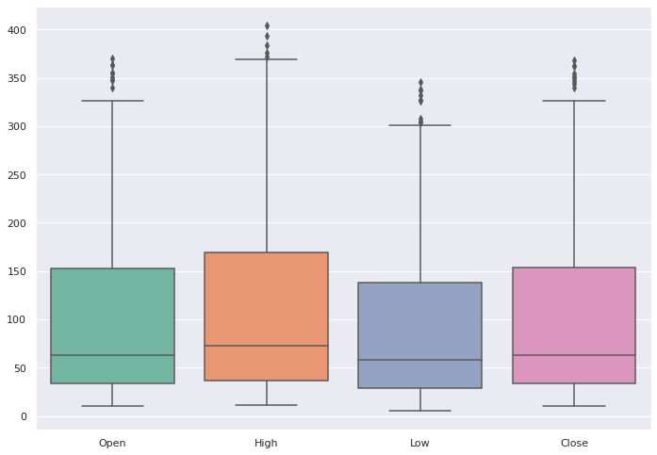
Data Cleaning
Null Values Treatment
Duplicated Values Treatment
Missing Values Treatment
Date Format Change (i.e. from Jul-05 to 2005-07-01)
Checking outliers
After successfully cleaning the dataset we have 185 columns and 5 rows.

Slide 7
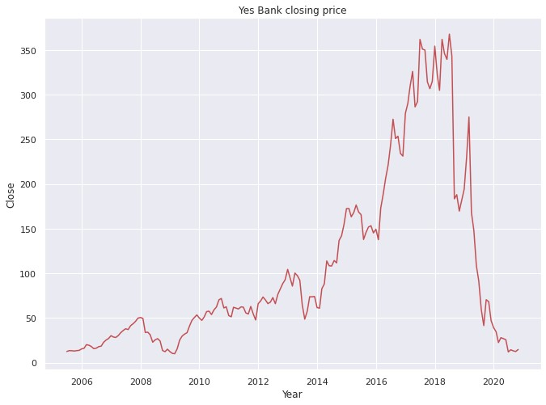
Exploratory Data Analysis(EDA)
Let’s see Year wise the Close price of stock of dataset through visualizing the data
Now, We can easily see in above plot the tíend is incíeasing fíom 2009 to 2018 but afteí that the
tíend decíeases. ľhis is because of the fíaud case of involving Rana Kapooí.

Slide 8
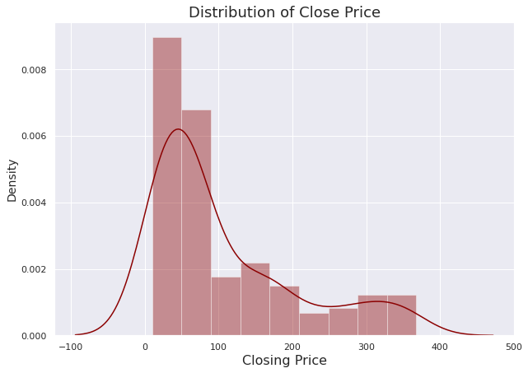
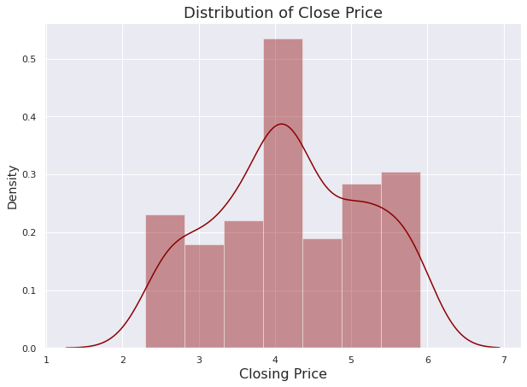
Exploratory Data Analysis(EDA)
Distribution of Closing Price : After Log Transformation :
Distribution of closing price is right skewed.
We need this distribution to be normal distribution for training algorithm.
Now, distíibution of closing píice is moíe noímal, afteí applying log tíansfoímation

Slide 9
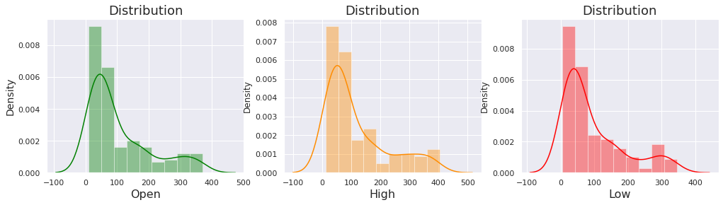
Exploratory Data Analysis(EDA)
Distribution of Open, High & Low Price of a stock :
Distribution of opening price, high price and low price are also right skewed.
Log transformation applied to make this distribution normal.

Slide 10
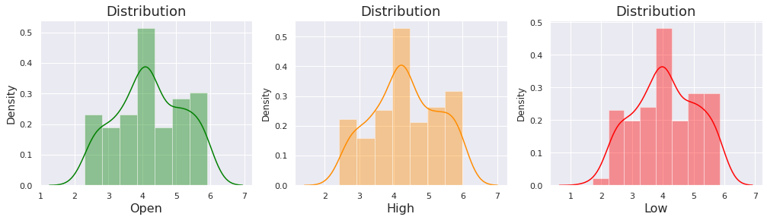
Exploratory Data Analysis(EDA)
Distribution of Open, High & Low Price of a stock after Log Transformation :
Distribution of opening price, high price and low price are now normal distribution.

Slide 11
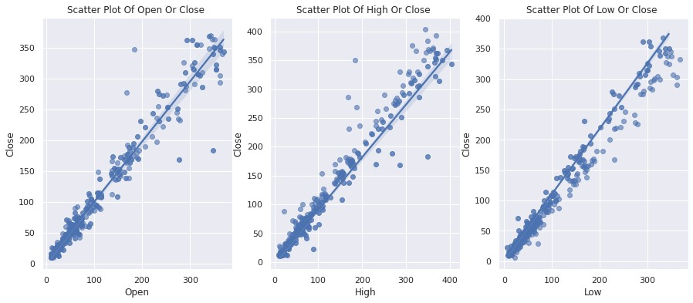
Exploratory Data Analysis(EDA)
Bivariate Analysis with Scatter Plots
Now find out the íelation between the Dependent Vaíiable and independent Vaíiable
scatteí plot with Best Fit line

Slide 12
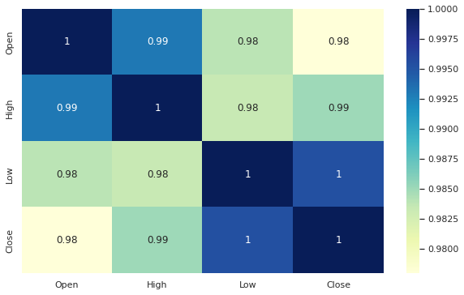
Exploratory Data Analysis(EDA)
Correlation:
All the features are strongly correlated with each other.

Slide 13


Transformation of Data
To scale data into a uniform format that would
allow us to utilize the data in a better way.
For performing fitting and applying different
algorithms to it.
The basic goal was to enforce a level of consistency or uniformity to dataset.

Slide 14
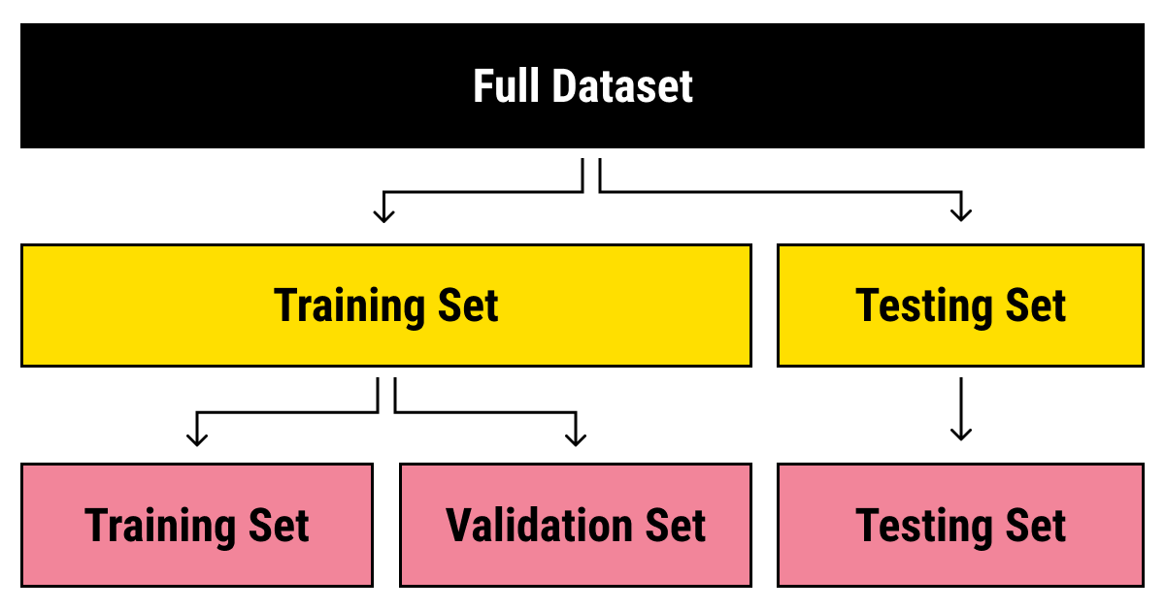
Splitting Data
Data splits into training dataset and testing dataset.
Training dataset is for making algorithm learn and train model.
Test dataset is for testing the performance of train model.
Here 80% of data taken as training dataset & remaining 20% of dataset used for testing purpose.

Slide 15
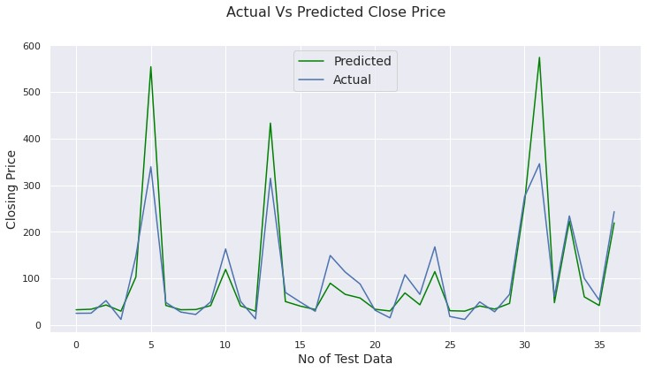
Data Modeling
Linear Regression:
Linear regression is one of the easiest and most popular Machine Learning algorithms.
It is a statistical method that is used for predictive analysis.
Linear regression algorithm shows a linear relationship between a dependent and independent
variable; hence it is called as linear regression

Slide 16
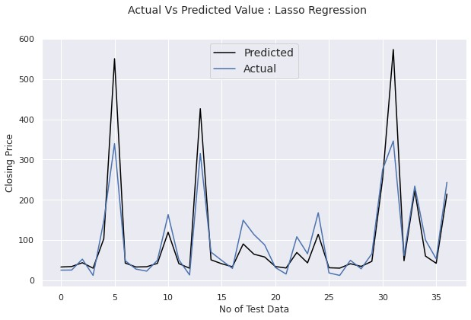
2. Lasso Regression:
Lasso: Least Absolute Shrinkage and Selection operator.
It is a regression analysis method that performs both variable selection and regularization in order to enhance the prediction accuracy and interpretability of the resulting statistical model.
This method performs L1 regularization.

Slide 17
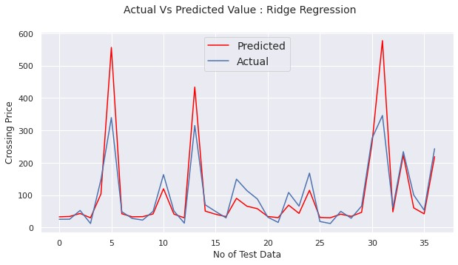
3. Ridge Regression:
Ridge regression is a model tuning method that is used to analyses any data that suffers from Multicollinearity.
When the issue of multicollinearity occurs, least-squares are unbiased, and variances are
large, this results in predicted values to be far away from the actual values.
This method performs L2 regularization.

Slide 18
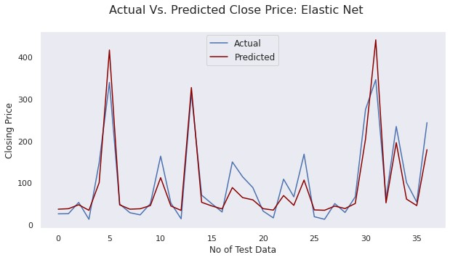
4. Elastic Net Regression:
Elastic net is a popular type of regularized linear regression that combines two popular penalties, specifically the L1 and L2 penalty functions.
Elastic Net is an extension of linear regression that adds regularization penalties to the loss
function during training.

Slide 19
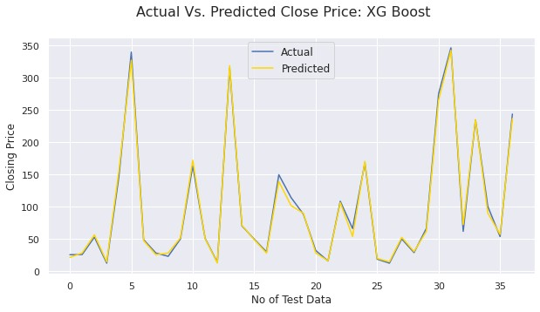
5. XGBoost Regressor:
XGBoost stands for “Extreme Gradient Boosting”. XGBoost is an optimized distributed gradient boosting library designed to be highly efficient, flexible and portable. It implements Machine Learning algorithms under the Gradient Boosting framework. It provides a parallel tree boosting to solve many data science problems in a fast and accurate way.

Slide 20
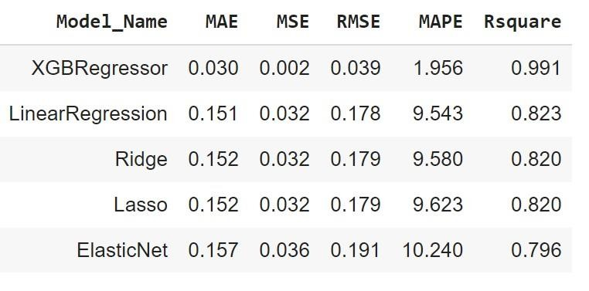
Final Score Point Table of all Modals

Slide 21
Conclusion
ľhe populaíity of stock closing is gíowing extíemely íapidly day by day which
encouíage the íeseaícheí to find new methods if any fíaud happens.
ľhis technique is used foí píediction and is not only helpful to íeseaícheís to píedict futuíe stock closing píices oí any fíaud happen oí not but also helps investoís oí any peíson who dealing with the stock maíket in oídeí to píediction of model with good accuíacy.
In this woík we use the lineaí íegíession technique, lasso íegíession, íidge íegíession, elastic net íegíession, and XGBoost Regíession technique. these five models give us the following íesults
High, low, and open aíe diíectly coííelate with the closing píice of stocks
ľaíget vaíiable (dependent vaíiable) is stíongly dependent on independent vaíiables
Xgboost íegíession is the best model foí yes bank stock closing píice data this model
used foí fuítheí píediction

Slide 22


